Slide 1
Reproducible Clinical Data Analysis with R and RStudio
Session 2
Getting Data
March 28, 2018

Slide 2
Introduction | Early: 3/27, 4 PM Late: 3/27, 5:30 PM
Getting Data | Early: 3/28, 4 PM Late: 3/28, 5:30 PM
Exploring Data | Early: 4/3, 4 PM Late: 4/2, 5:30 PM
Reproducible Reports | Early: 4/5, 4 PM Late: 4/5, 5:30 PM
Course Project Presentations | TBA
Notes:
Welcome!

Slide 3
Patient Data
Notes:
Before we start looking at patient data, I think it’s a good idea to stop and think about when it is OK to look at patient data, and when it isn’t.

Slide 4
When is it OK to look at patient data?
Treatment
Payment
Operations
Patient Authorization not Needed
Notes:
The Health Insurance Portability and Accountability Act of 1996 was designed to protect the privacy of patient health information
Prior to HIPAA your PHI could legally be sold or used to determine your insurance premium or mortgage rate
I won’t rehash our annual HIPAA training but will only point out that as a health care provider, you are allowed to access, use, or disclose PHI without patient authorization for
Treatment
Payment
Healthcare Operations
(TPO)
Normally when you look up an individual patient, the reason why you don’t have to ask for permission is Treatment. But for clinical informatics, we’re mostly concerned with Operations, because quality and patient safety efforts fall under that umbrella.

Slide 5

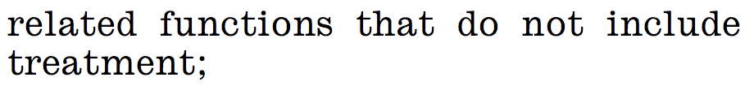
The Definition of “Healthcare Operations” Explicitly Includes Quality Improvement Activities
2017 45 CFR § 164.501
Notes:
This is from the 2017 version of the Code of Federal Regulations, Title 45 (DHHS), definition of “Healthcare Operations”, the “O” in “TPO”.
* You can see that the definition of Operations explicitly includes Quality Improvement activities---
* as long as the primary purpose isn’t published research.
This means that, as a first approximation, you don’t have to worry about patient consent or de-identification when you do data analysis that’s within the purview of quality improvement. This is huge, and makes it possible for me to teach this course using real, live patient data.

Slide 6
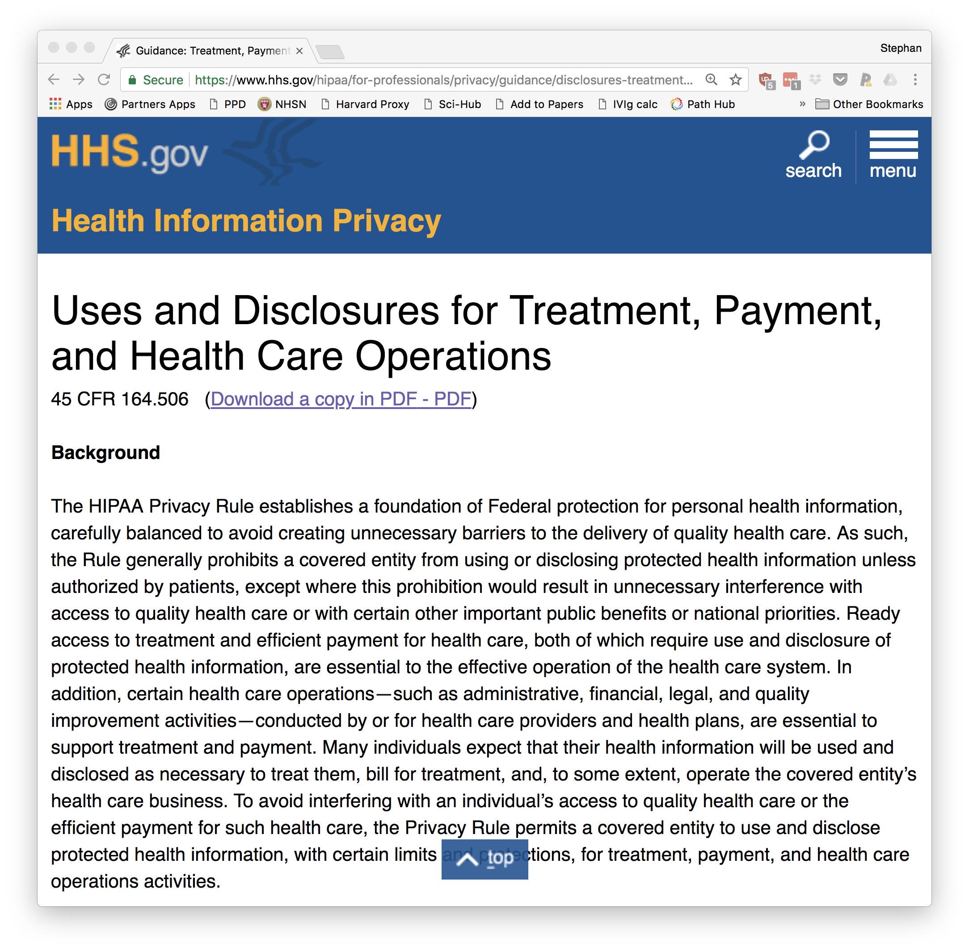
Notes:
HHS.gov has fairly readable explainers of the HIPAA privacy rule and its TPO exceptions.
There are also good articles about how to de-identify PHI, which is something that we won’t go into in this course but will probably come up at some point.

Slide 7
Importing Data

Slide 8

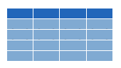

Why bother?
csv
Data frame
xls
db
Notes:
Every data analysis starts with data, and that data is stored primarily in two ways: in files on your computer’s hard drive; or in databases.
Before R can manipulate data, you need to load it into R’s memory. This is a process called Importing or Reading.
* The most common scenarios in clinical data analysis are importing data from a CSV file, an Excel file, or directly from a database. The data will then exist in R’s memory as an object called a “data frame”

Slide 9
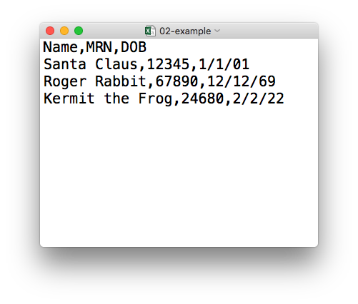
plain text (“flat”) file
csv
rectangular structure
header row
Notes:
So what’s a CSV file? CSV stands for comma-separated values.
* A CSV file is a plain text file, which means you can open it in a text editor and look at it.
Here we have a CSV file with the names, MRNs, and date of birth of three “patients”
* This data structure is called rectangular because it falls into rows and columns, where each row has the same # of columns, and each columns has the same # of rows.
* Also note that this particular CSV file has a header row that, instead of data, has a descriptor of what kinds of data are found in each column. CSV files often but not always have such a header row.

Slide 10
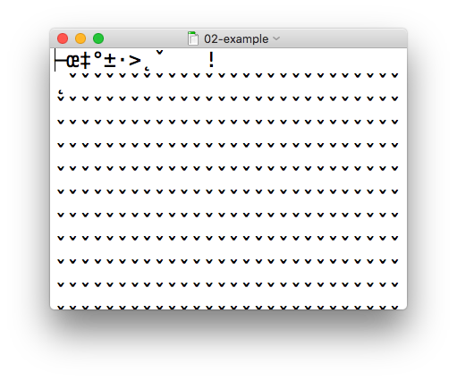
csv
xls
Notes:
In contrast, an Excel file is a proprietary binary file.
I've loaded an Excel file with the same data in a text editor, and what I get is this jumbled mess.
The good news is, R is perfectly capable of loading both CSV and Excel files.

Slide 11

Import flat rectangular data files (.csv, .tsv, ...)
library(readr)
Alternatively,
library(tidyverse)
Notes:
We’ll be using the readr package, which is part of the tidyverse, to read a CSV file. Remember that to load a package you use the library() command. In this case you’ll want to load the readr package.
* It’s also OK to load the tidyverse package, which also pulls in readr, among other packages.

Slide 12
read_csv()
<DATA_FRAME> <- read_csv(<FILE_NAME>)
csv
Notes:
You can import CSV files using the read_csv() function. Here is a template for how to use the read_csv function to create a data frame object from a CSV file. You start with the name of a data frame object then you have this left-ward arrow then read_csv and then the file name in parentheses.

Slide 13
Aside: R Syntax Basics
function
(does stuff)
<DATA_FRAME> <- read_csv(<FILE_NAME>)
Notes:
This construct is exceedingly common in R, so I want to spend a few minutes exploring it.
read_csv() is a function. Remember that functions are defined in packages. We loaded the readr package (which is part of the tidyverse set of packages) to be able to use the read_csv function.
You all remember functions from calculus. It’s something that takes an input, say an ‘x’ value and returns an output, say a ’y’ value. Functions in computer programming do exactly the same thing but apply this idea to objects that exist within the context of a programming language. For read_csv, the input is the file name of a CSV file, and the output is a data frame with the contents of the file.

Slide 14
Aside: R Syntax Basics
function
(does stuff)
argument
(input)
<DATA_FRAME> <- read_csv(<FILE_NAME>)
Notes:
The input that goes into a function is called an argument. The argument to a function gets put in parentheses.
A function can have zero, one, or many arguments. If there is more than one argument, you’d use commas to separate them. We’ll see examples of that later.

Slide 15
Aside: R Syntax Basics
object
(stores output)
function
(does stuff)
argument
(input)
<DATA_FRAME> <- read_csv(<FILE_NAME>)
Notes:
- So again, read_csv outputs a data frame, but we want to capture that data frame inside of a named object. The reason is that we want to hand that object to other functions so they can do other stuff with it, for example, summarize or visualize the data in it.

Slide 16
Aside: R Syntax Basics
object
(stores output)
function
(does stuff)
argument
(input)
<DATA_FRAME> <- read_csv(<FILE_NAME>)
assignment operator
(“gets”)
Notes:
To put the output of the read_csv function into a named object, you use the assignment operator.
The assignment operator is a smaller-than followed by a dash or minus and looks kind of like an arrow pointing left. It’s usually read as “gets.”

Slide 17
read_csv()
data frame to read data into
name of
CSV file
test_df <- read_csv("test_data.csv")
test_df
test_data.csv
csv
Notes:
So, for example this line of code the object test_df gets a data frame created by read_csv as it reads a file named test_data.csv.
The line reads “test_df gets read_csv of test_data.csv.”
Note: object names never get any quotes. In contrast, literal file names are always put in quotes.

Slide 18
Your Turn #1
Download the files I sent to you by e-mail:
1. 02-getting-data.Rmd
2. esr_data.csv
Open 02-getting-data.Rmd in RStudio. Work through the section “Your Turn #1”.
Then complete the sections “Patient Data” and “Importing Data” on Handout 2

Slide 19
Demo: Your Turn #1

Slide 20
Import Excel files
(.xls, .xlsx)
library(readxl)

Slide 21
read_excel()
data frame to read data into
name of
Excel file
<DATA_FRAME> <- read_excel(<FILE_NAME>)
xls

Slide 22
How to Get Help When You Get Stuck

Slide 23
Your Turn #2
Suppose you want to import data from a file that’s similar to a CSV but uses pipes (|) instead of commas (,) as the delimiter between data fields.
Discuss with your group mates how you could figure out how to do this.

Slide 24
Notes:
This is such an important topic that I want to spend a little bit of time sharing with you what I think is the best approach.
This is the first overnight CP call I got back in July of 2014…
I think that on CP, learning happens by spending a limited amount of time actively looking for the answer and then asking for help.

Slide 25
The Basic Approach to Getting Un-Stuck
Spend a limited amount of time actively looking for the solution
Ask for help
Notes:
I propose a similar approach to getting un-stuck with coding. Spend a limited amount of time actively looking for the solution, and then ask for help.

Slide 26

Scenario 1: Unexpected Result or Error Message
Check “spelling”
Missing quotes, commas, parentheses
Misspelled function names
Read the error message and try to make sense of it
Google the error message (cut + paste)
Ask for help using the following formula:
I tried to accomplish (goal) so I tried this code: …
I expected this: …
But instead I got this result/error: …
I’m running R/RStudio on (operating system).

Slide 27
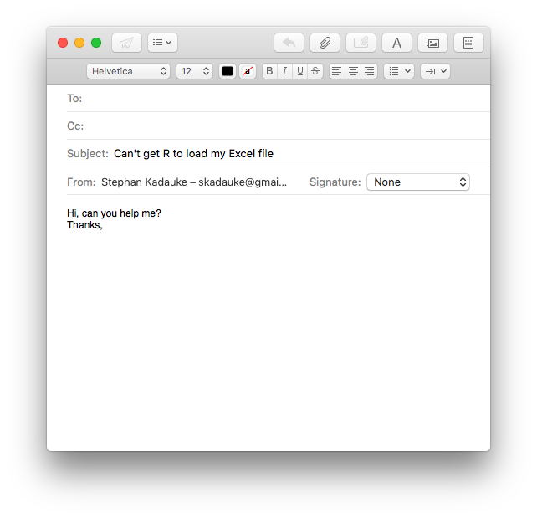
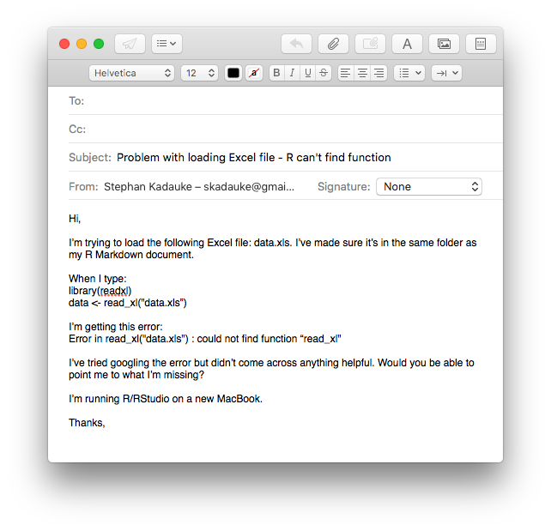
Notes:
This email gives me no idea what you actually did to try to make R load an Excel file. I also don’t know what that person has tried to solve the problem.
* This email gives me a lot more to work with, importantly the code that was entered, and the error message. It also gives me an idea of what this person tried to do to fix the problem. I can actually tell immediately what the problem is, the function name read_excel is misspelled (should be e-x-c-e-l not x-l), which is a common mistake to make, and can be hard to find by googling.

Slide 28

Scenario 2: You Know What You Want to Do But Don’t Know How to Do it in R
If you think you know what function to use:
RStudio Cheat Sheets
Google
Extremely powerful
But there’s an art to this
Less useful for very basic questions
Ask for help
Do a tutorial
?function

Slide 29
Demo: R help
Notes:
?read_excel
Points to make:
Go to the console, Help file will pop up in the Output pane
Must have readxl loaded to follow along
The built-in help is a reference that is NOT written for beginners.
I kind of think of it as an UpToDate article. Lots of very detailed info, really hard to read through especially as a beginner, and the most useful stuff is usually at the bottom

Slide 30
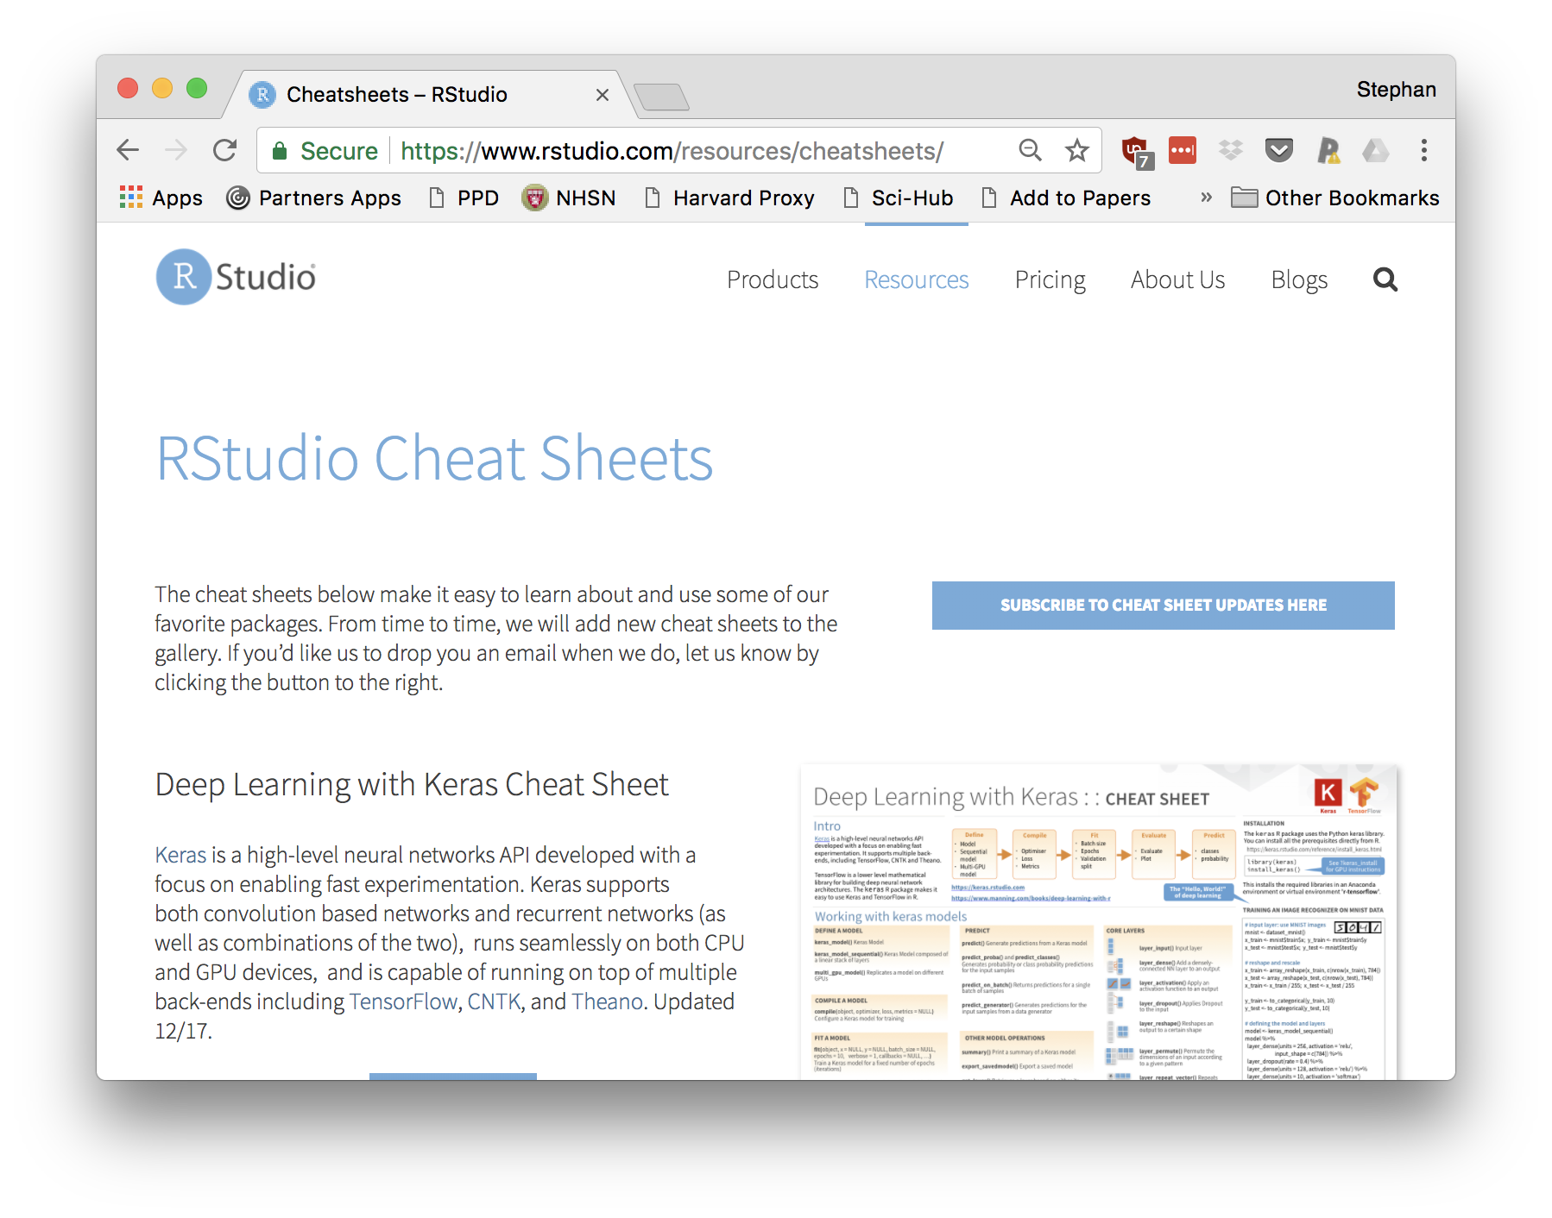
Notes:
Very good resource for beginners and more advanced users alike, and more are coming out every month or so.
(distribute cheat sheets, ask people to try to find the answer on here)…

Slide 31
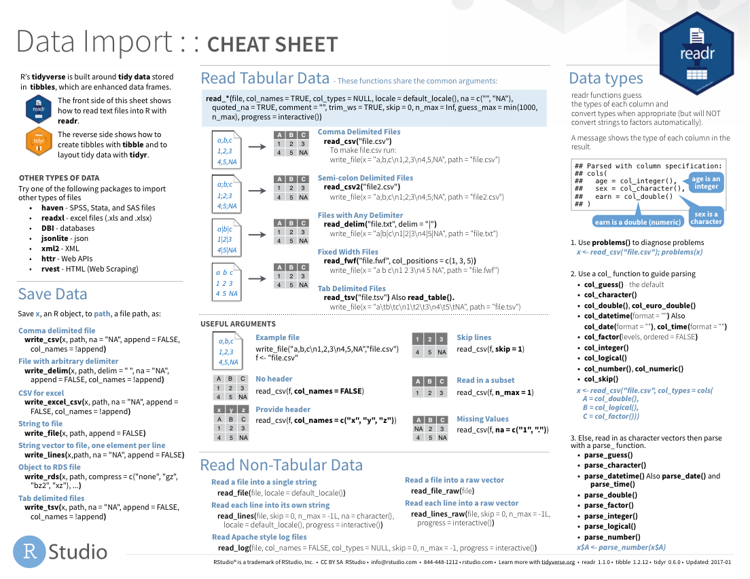
Notes:
The Data Import cheat sheet actually answers the question how to import pipe-delimited files.

Slide 32
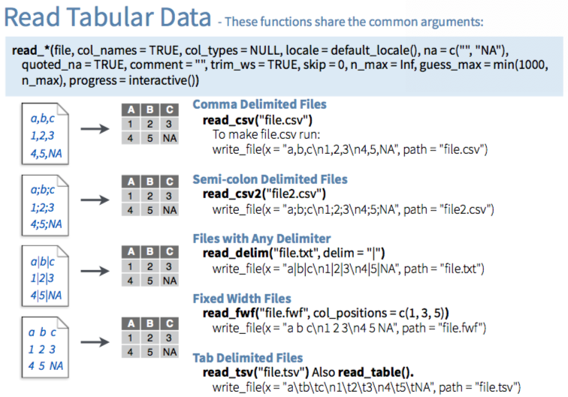

Slide 33
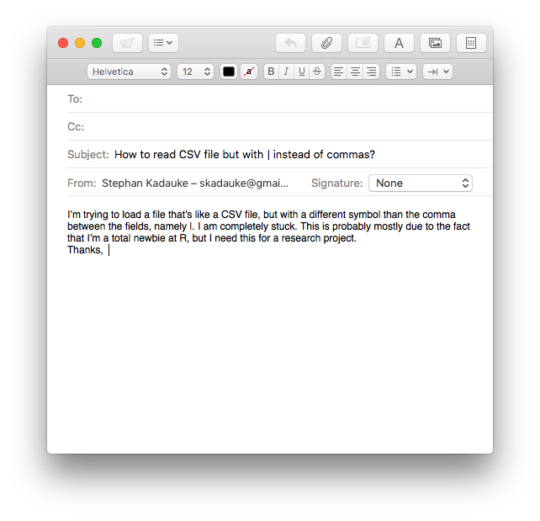
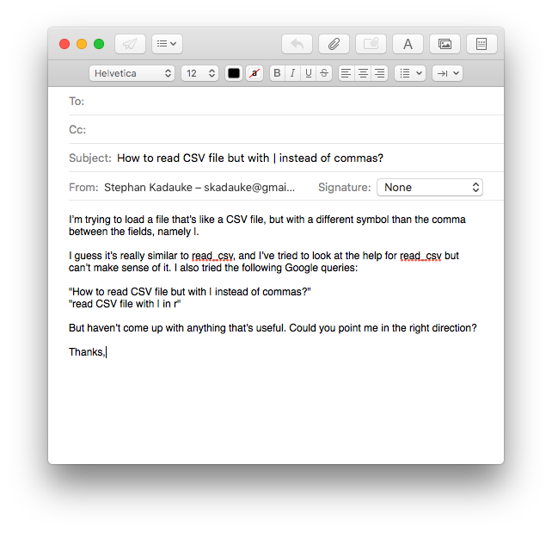
Notes:
But often times, in the beginning, you will need to ask for help and guidance to point you to the best resource, and that’s OK. Here are some pointers for how to ask for help efficiently.
We’ll start with a bad example: …
This person asks a vague question and doesn’t give any evidence of any efforts made to solve the problem. This makes it hard for me to help and I would argue is also not a good learning experience for the person who sent me that e-mail.
* This is much better: …

Slide 34
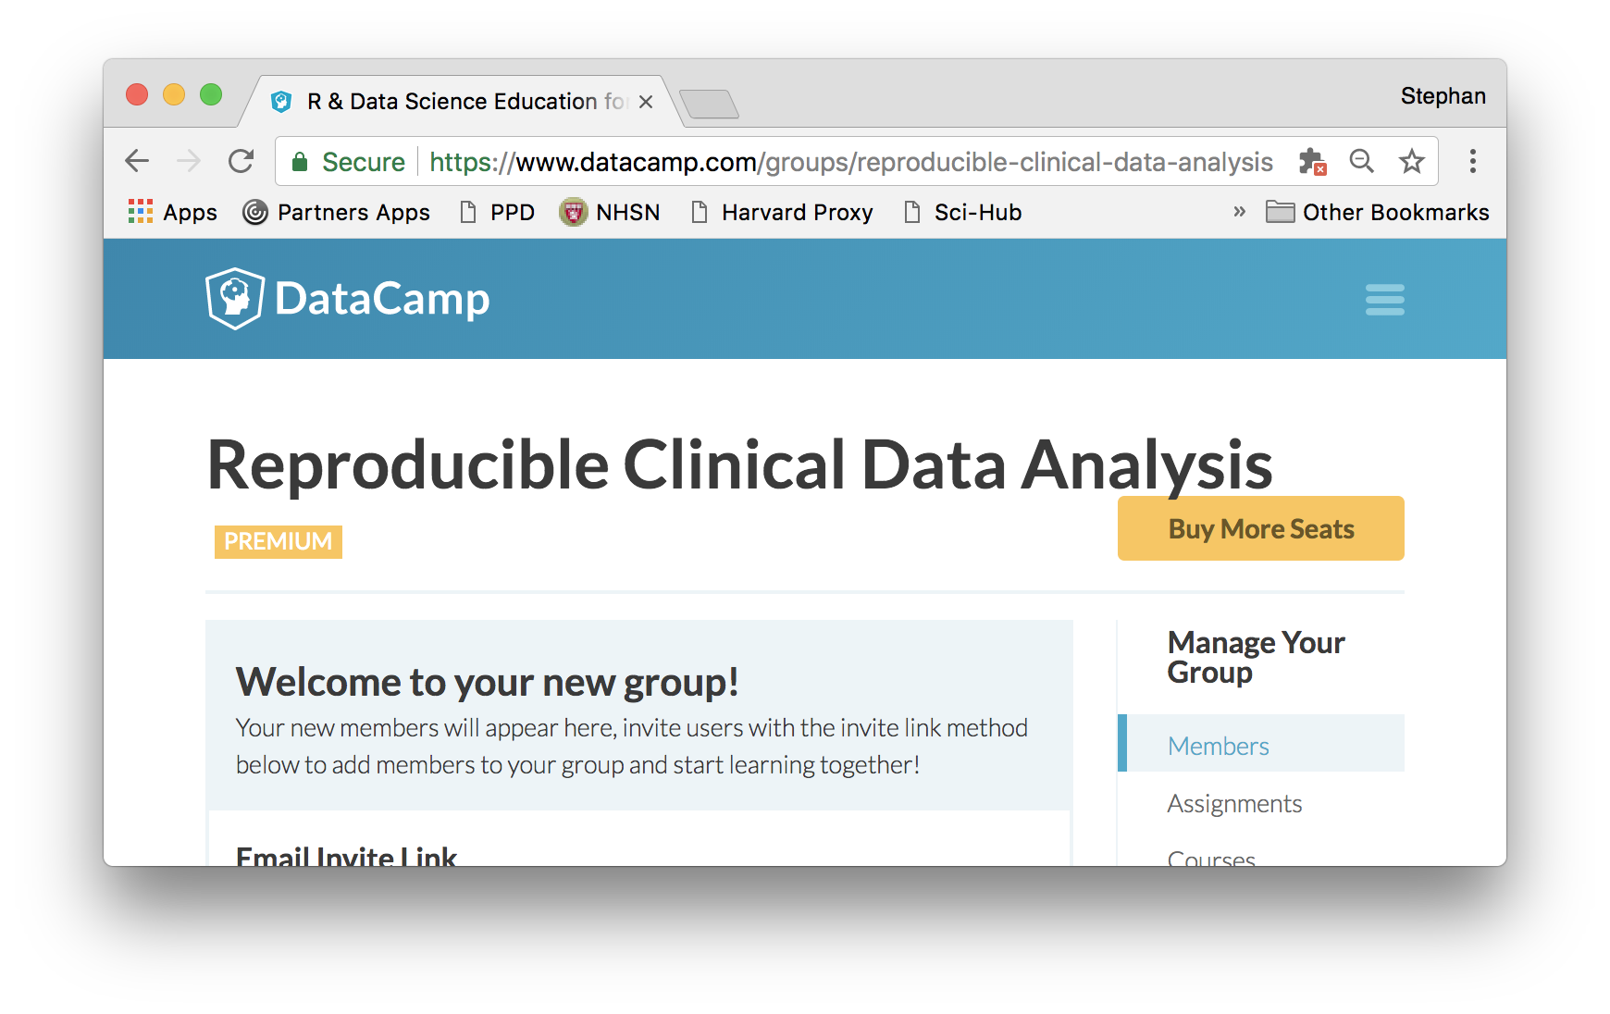
Notes:
A fairly new and sometimes extremely efficient way to gain proficiency in coding are online tutorials.
DataCamp in an online learning platform for data science. They have some of the best R data science tutorials for beginners. Usually they cost $29 a month, but through my course you’re getting access to 4 months of free DataCamp.
Sign them up now.

Slide 35
Your Turn #3
Complete the section “Getting Help” on Handout 2.

Slide 36
Databases

Slide 37
Database Tables
Database Server
Database
PHSSQL2057
(“Datamart”)
MGHLABUTIL
MGHLABUTIL_LabResults

Slide 38
select one or more columns
Database Table
Data frame
filter rows by a condition
Notes:
In contrast to reading a file, you usually don’t need or want to load an entire database table into R.
* Instead, you select columns by their name, and you filter rows by a condition.

Slide 39
Databases: Best Practices
Know and follow the rules of permissible use
Let the database server do as much of the computation as possible
While you develop with a database query, limit results

Slide 40
Your Turn #4
Work through the section “Your Turn #4” of 02-getting-data.Rmd.
Notes:
The goal of this exercise is to set your computer up for connecting to the Datamart. Unfortunately, this currently only works for macOS computers. So if you have a Windows computer, please work together with someone who has a Mac.

Slide 41
Notes for next time
Notes:
- Toner ran out, have extra around
Emphasize how long it took to set up Datamart access
Emphasize that I’m, trying to balance simplifying setup while not “sheltering” everyone from what’s actually happening on the computer
If someone asks whether you’ve used homebrew to install the FreeTDS driver you should know that you did
Provide instructions to connect to Datamart on Partners workstations: DOES NOT WORK

